Slide 1

Control System Components ICE-3015
Dr. RK and Mr. CRS
Department of Instrumentation and Control Engineering
Contact Details:
kr.kini@manipal.edu
cr.srinivasan@manipal.edu

Slide 2
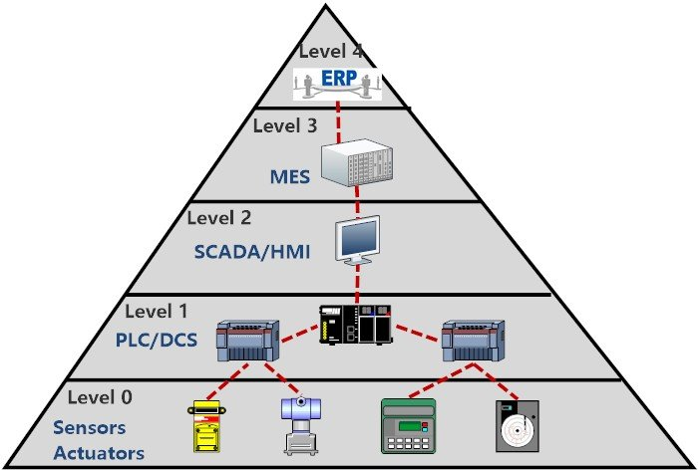
What are we in for?
Primary components of industrial instrumentation systems: sensors, drives and actuators
Industrial automation- A closed loop system
Where are we in the automation pyramid?
Process
Continuous and Discrete
Parameters
Continuous and Discrete
Variables
Actuators
Sensors
DAC
ADC
Controller
Field level
Output Devices
Input Devices

Slide 3
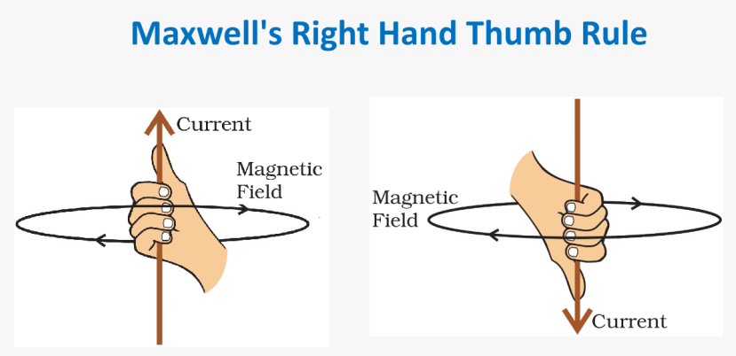
Fundamentals
According to Maxwell right hand thumb rule if we tend to hold a straight current carrying wire in our right hand such that our thumb represents the direction of the current then the curls of our fingers would represent the direction of the magnetic field lines.

Slide 4
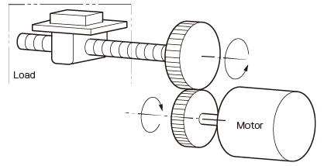
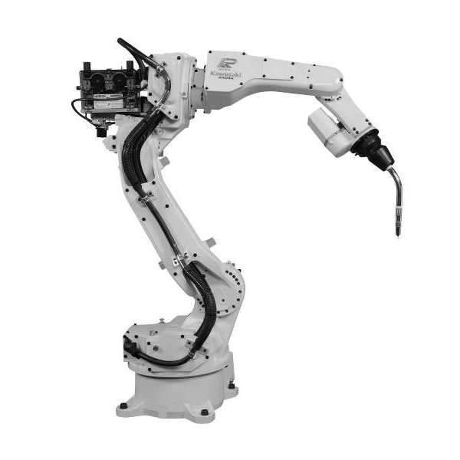
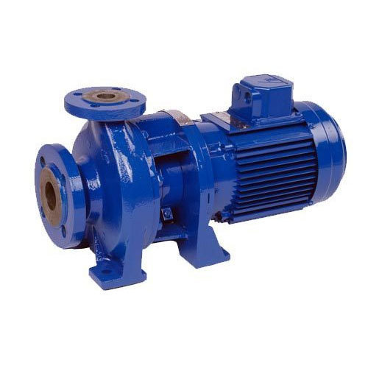

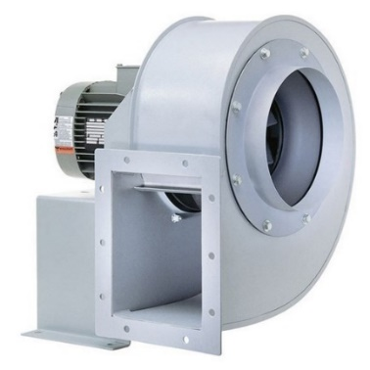
Electric motors
What is an electric motor?
Electrical energy
Motor
Mechanical energy
Generator
Motors in industries

Slide 5
Types of Electric motors
Electric Motors
DC Motors
AC motors
Special motors
DC Shunt motor
DC Series motor
DC compound motor
Permanent magnet dc motor
Single phase induction motor
Three phase induction motor
Synchronous motor
BLDC motor
Stepper motor
Universal motor
Linear motor
Servo motor

Slide 6
Types of Electric motors
DC Motors: Shunt motors, Series motors, Separately excited motors, Compound motors, permanent magnet motors
Shunt motors: Constant speed applications- lathe machines, vacuum cleaners, blowers, compressor
Series motors: High starting torque applications- cranes, hoist, traction
AC Motors: Induction motors- Squirrel cage, Slip ring, Linear induction
Synchronous- Wound field, Permanent magnet
DC motors vs induction motors:
Higher cost, weight, volume, inertia, frequent maintenance, unsuitability for use in explosive environments
Squirrel cage IM: Cost one-third of DC machines. Previously used for constant speed applications
Brushless DC motors: Maintenance free motors- Low power high speed applications, servo applications
Stepper motors: Robotics applications
Switched reluctance motors: Very light rotor weight, easy to accelerate, decelerate- electric vehicles, aerospace applications

Slide 7
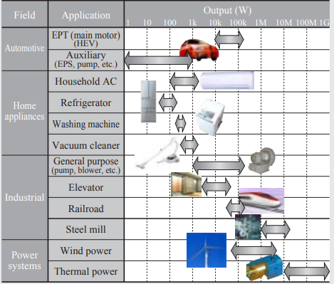
Electric motors: Choice, Use and Specs.
What is the type of available supply?
What is the type of load?
What is the load torque?
What is the maximum speed requirement?
What is motor duty cycle?
Is a precision position control required?
What is the type of environment where the motor is installed?
What is the motor life expectancy/ Maintenance?
Budget
Type of motor, Rated voltage, Rated current
Rated speed, Rated power

Slide 8
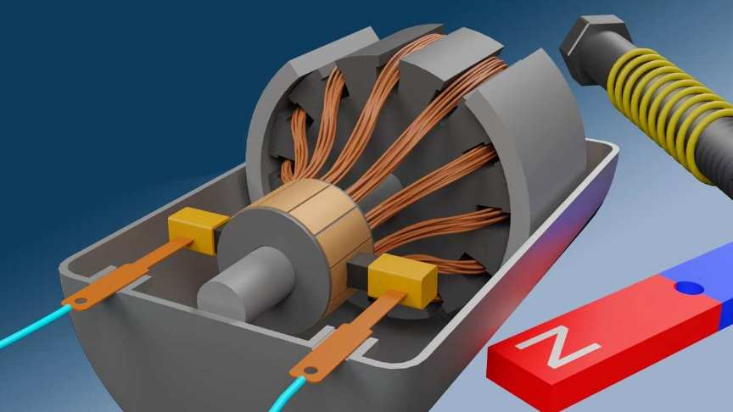
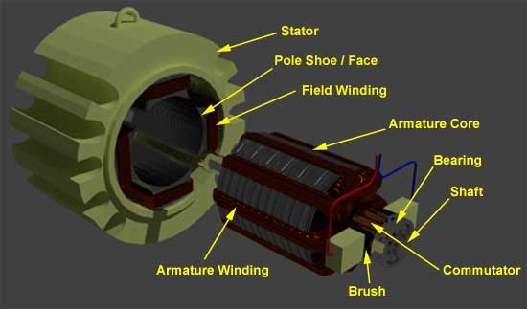
Parts of a Motor
Two major parts
Stator – The static part that houses the field windings and receives the supply and,
Rotor – The rotating part that brings about the mechanical rotations.
Detailed parts:
Yoke
Armature or rotor
Field magnet
Commutator
Brushes
DC power supply of some sort

Slide 9
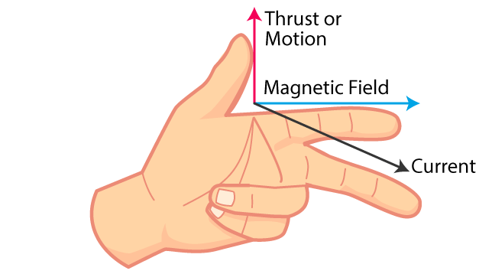
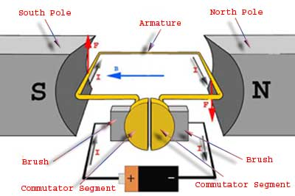
Fundamentals DC Motor

Slide 10
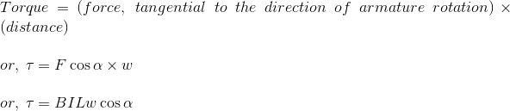
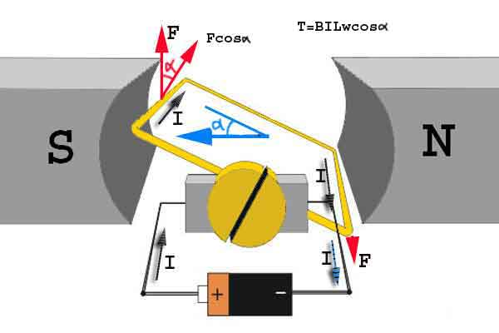
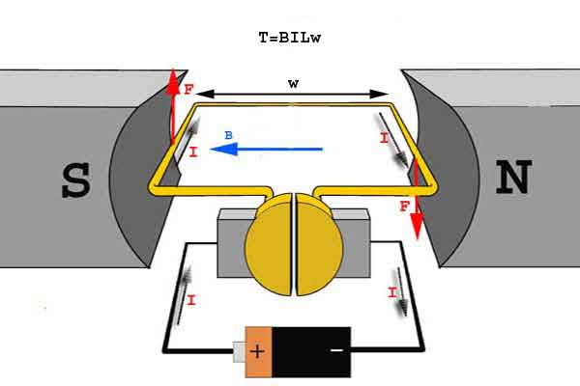
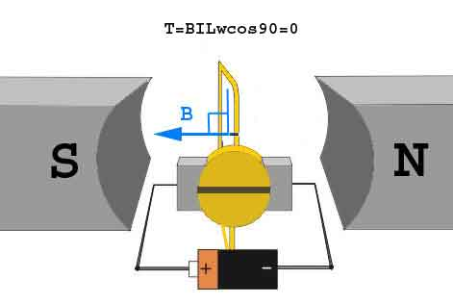
Fundamentals of DC motor

Slide 11
DC motor operation
When armature winding is connected to a DC supply, an electric current sets up in the winding. Permanent magnets or field winding (electromagnetism) provide the magnetic field and current-carrying armature conductors experience a force due to the magnetic field.
By applying Fleming’s Left-Hand Rule, the conductor on the left side always experiences a force in an upward direction while the conductor on the right side experiences a downward force. Hence, unidirectional torque is achieved in DC motors.
The interaction of the current-carrying conductor with the changing magnetic field produced by the field winding induces an EMF in the conductor and this EMF acts in the opposite direction to the applied voltage.

Slide 12
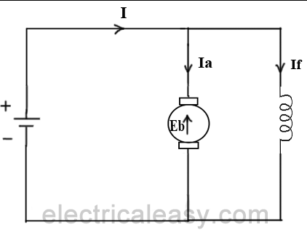
Back electromotive force in a motor
When the armature of a motor is rotating, the conductors are also cutting the magnetic flux lines and hence according to the Faraday's law of electromagnetic induction, an emf induces in the armature conductors.
The direction of this induced emf is such that it opposes the armature current (I_{a}). The diagram below illustrates the direction of the back emf and armature current.

Slide 13
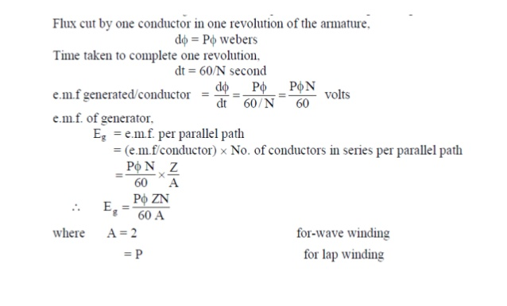
Back emf
P = number of field poles Ø = flux produced per pole in Wb (weber) Z = total no. of armature conductors A = no. of parallel paths in armature N = rotational speed of armature in revolutions per min. (rpm)

Slide 14
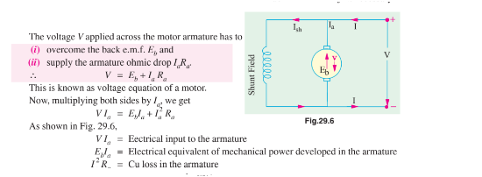
Equation of a motor

Slide 15
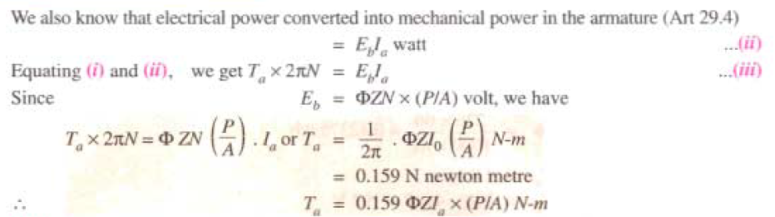
Torque in a DC Motor

Slide 16
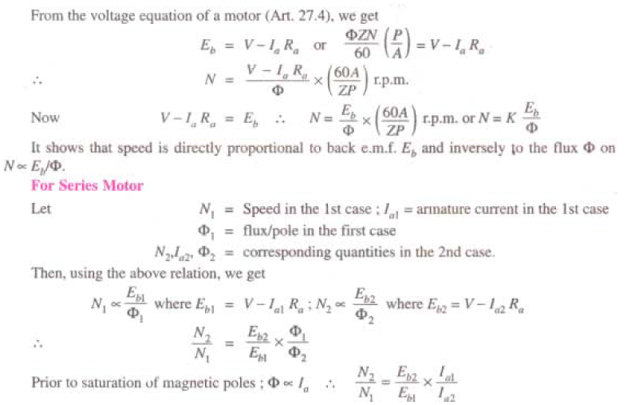
Speed in a DC Motor

Slide 17
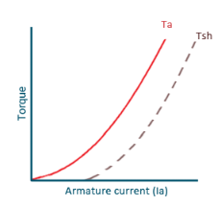
Motor Characteristics - Torque Vs. Armature Current
We know that torque is directly proportional to the product of armature current and field flux, T_{a} ∝ ɸ.I_{a}.
Hence, before magnetic saturation Ta α Ia². Therefore, the Ta-Ia curve is parabola for smaller values of Ia. After magnetic saturation of the field poles, flux ɸ is independent of armature current Ia. Therefore, the torque varies proportionally to Ia only, T ∝ Ia.
Therefore, after magnetic saturation, Ta-Ia curve becomes a straight line.

Slide 18
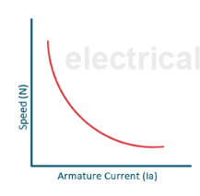
Motor Characteristics – Speed Vs. Armature Current
We know, N ∝ E_{b}/ɸ.
For small load current (and hence for small armature current) change in back emf Eb is small and it may be neglected. Hence, for small currents speed is inversely proportional to ɸ.
As we know, flux is directly proportional to Ia, speed is inversely proportional to Ia. Therefore, when armature current is very small the speed becomes dangerously high.
That is why a series motor should never be started without some mechanical load.
But, at heavy loads, armature current Ia is large. And hence, speed is low which results in decreased back emf Eb. Due to decreased Eb, more armature current is allowed.

Slide 19
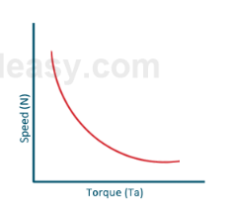
Motor Characteristics – Speed Vs. Torque
This characteristic is also called a mechanical characteristic.
From the above two characteristics of DC series motor, it can be found that when speed is high, torque is low, and vice versa.

Slide 20
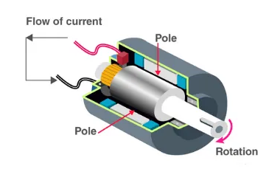
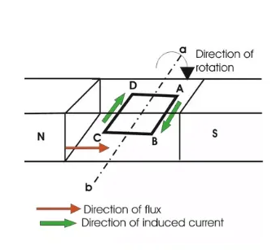
DC GENERATOR
DC generator converts mechanical energy into electrical energy.
Working principle is based on Faraday’s law of electromagnetic induction - When a conductor moves in a magnetic field it cuts magnetic lines of force, which induces an electromagnetic force (EMF) in the conductor.
The magnitude of this induced EMF depends upon the rate of change of flux (magnetic line force) linkage with the conductor. This EMF will cause a current to flow if the conductor circuit is closed.

Slide 21
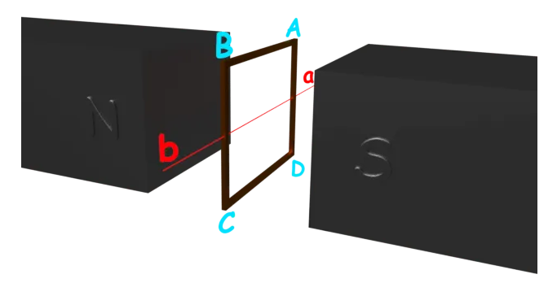
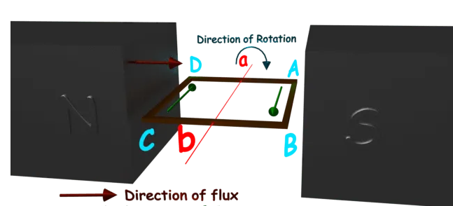
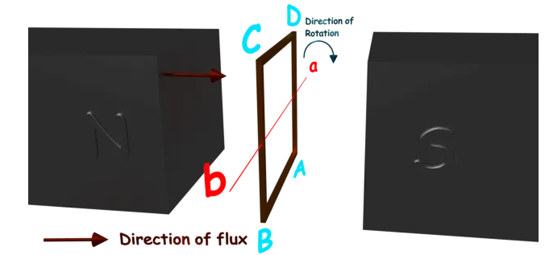
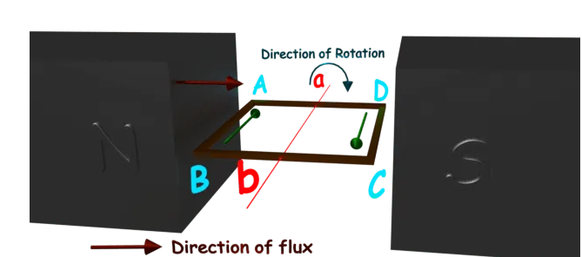
DC GENERATOR- Working

Slide 22
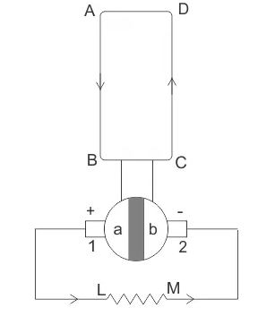
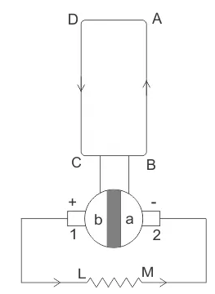
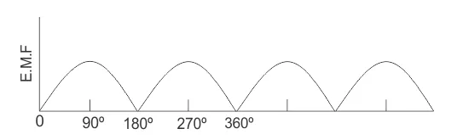
DC GENERATOR
Split rings, made of a conducting cylinder, get cut into two halves or segments insulated from each other.
We can see that in the first half of the revolution current always flows along ABLMCD, i.e., brush no 1 in contact with segment a.
In the next half revolution, the position of segments a and b are also reversed and brush no 1 coming in touch with segment b.
Hence, the current in the load resistance again flows from L to M

Slide 23
DC GENERATOR
ADVANTAGES:
DC generators generate large output.
They are lightweight as well as compact.
They give a reliable output.
DISADVANTAGES
Very expensive
Very hard to maintain.
Efficiency is lesser as compared to AC generators.

Slide 24
SPEED CONTROL DC MOTORS: ELECTRONIC METHOD
Solid state devices using diodes, SCRs and (thyristors) are becoming popular for controlling speed of motors.
These schemes have higher efficiency, higher accuracy, greater reliability and quicker response.
When run on AC supply, the average output voltage of rectifiers can be varied and the armature voltage of the motor can be adjusted to control its speed.
When run on DC supply, the DC voltage can be varied by chopper circuits.

Slide 25
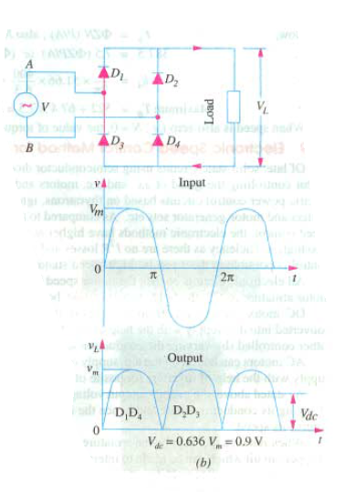
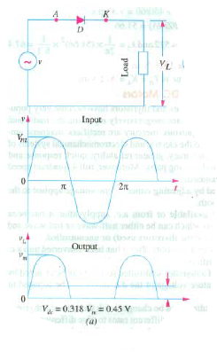
UNCONTROLLED HALF/FULL-WAVE RECTIFIERS

Slide 26
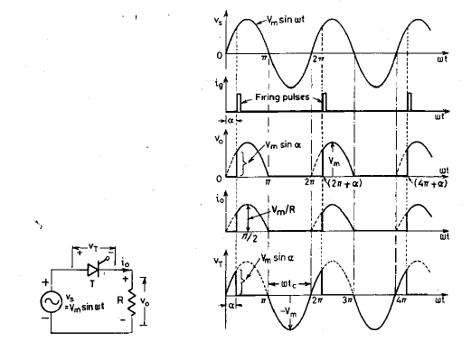
CONTROLLED SINGLE-PHASE HALF-CONTROLLED RECTIFIERS

Slide 27
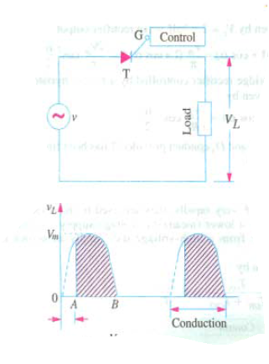
CONTROLLED SINGLE-PHASE HALF-CONTROLLED RECTIFIERS

Slide 28
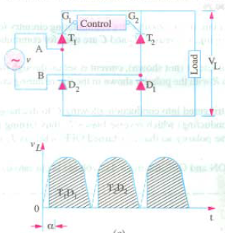
SINGLE-PHASE FULL-WAVE SEMI-CONTROLLED RECTIFIERS

Slide 29
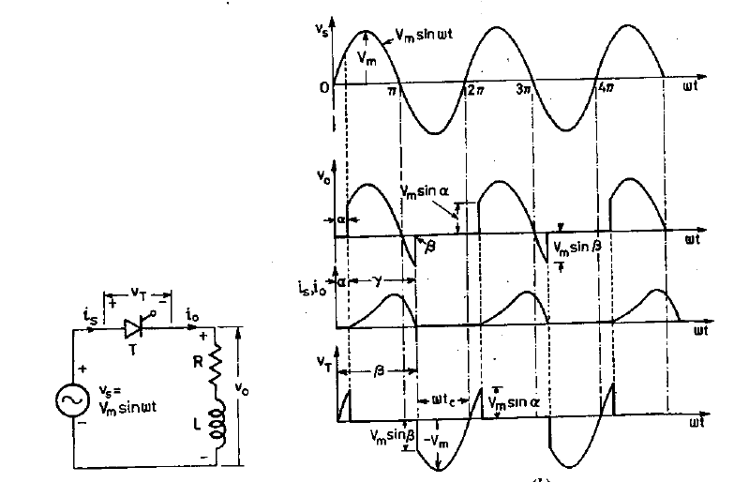
SINGLE-PHASE HALF-CONTROLLED RECTIFIERS RL LOAD

Slide 30
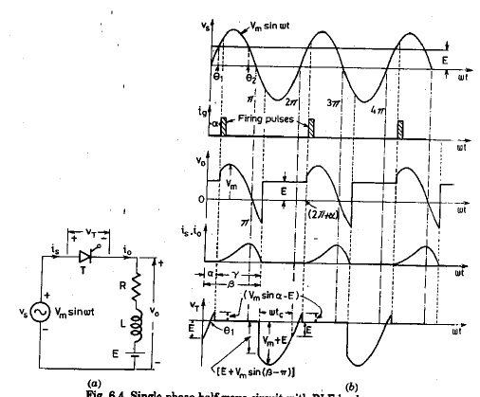
SINGLE-PHASE HALF-CONTROLLED RECTIFIERS RLE LOAD

Slide 31
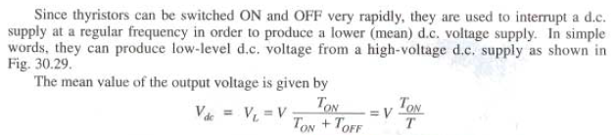
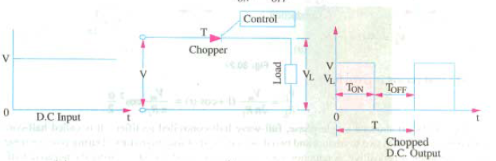
SPEED CONTROL VIA CHOPPERS

Slide 32
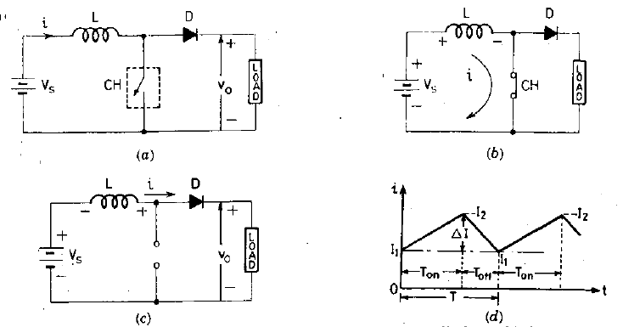
DC MOTOR SPEED CONTROL – Step up chopper

Slide 33
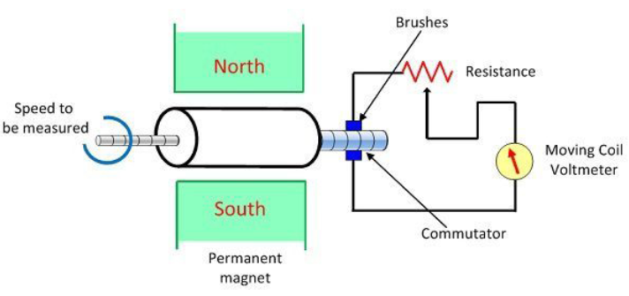
Tachogenerators
https://www.motioncontroltips.com/what-is-a-tachogenerator-and-when-is-it-used/
https://www.tachogenerators.co.uk/tachogenerators/shaft-mounted
https://www.tachogenerators.co.uk/tachogenerators/hollow-shaft
https://www.tachogenerators.co.uk/pdf/59271be96d355GT5.pdf

Slide 34
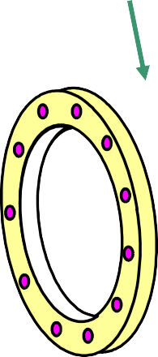
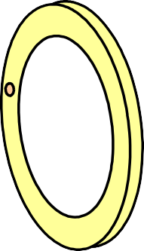
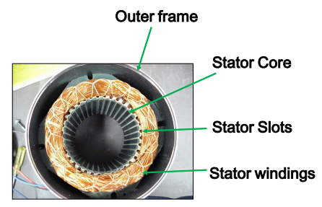
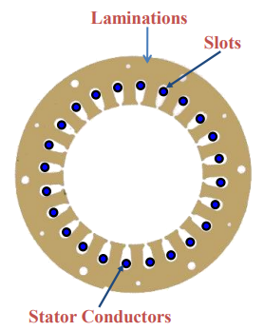
AC motor construction
An Induction motor is the most widely used AC motor in industrial and domestic applications.
Stator:
Stator frame: provides stator core
Stator core: laminated and slotted to carry the 3 phase windings
The 3 phase windings passes through slots of cast iron frame.
The balanced windings are displaced in slots by 120 degrees.
Rotating magnetic field is formed which causes rotor to rotate.

Slide 35
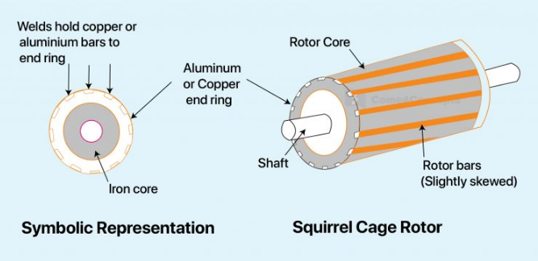
AC Motor – Squirrel Cage Rotor
Most applications prefer the usage of squirrel cage rotor since it is very simple, rugged and less maintenance is sufficient.
This rotor consists of cylindrical laminated core having slots for carrying conducting bars.
Copper or aluminium bars are placed in each slot and joined at each end by end rings.
The rotor bars are short circuited by end rings and hence it is not possible to add additional resistance to have torque.

Slide 36
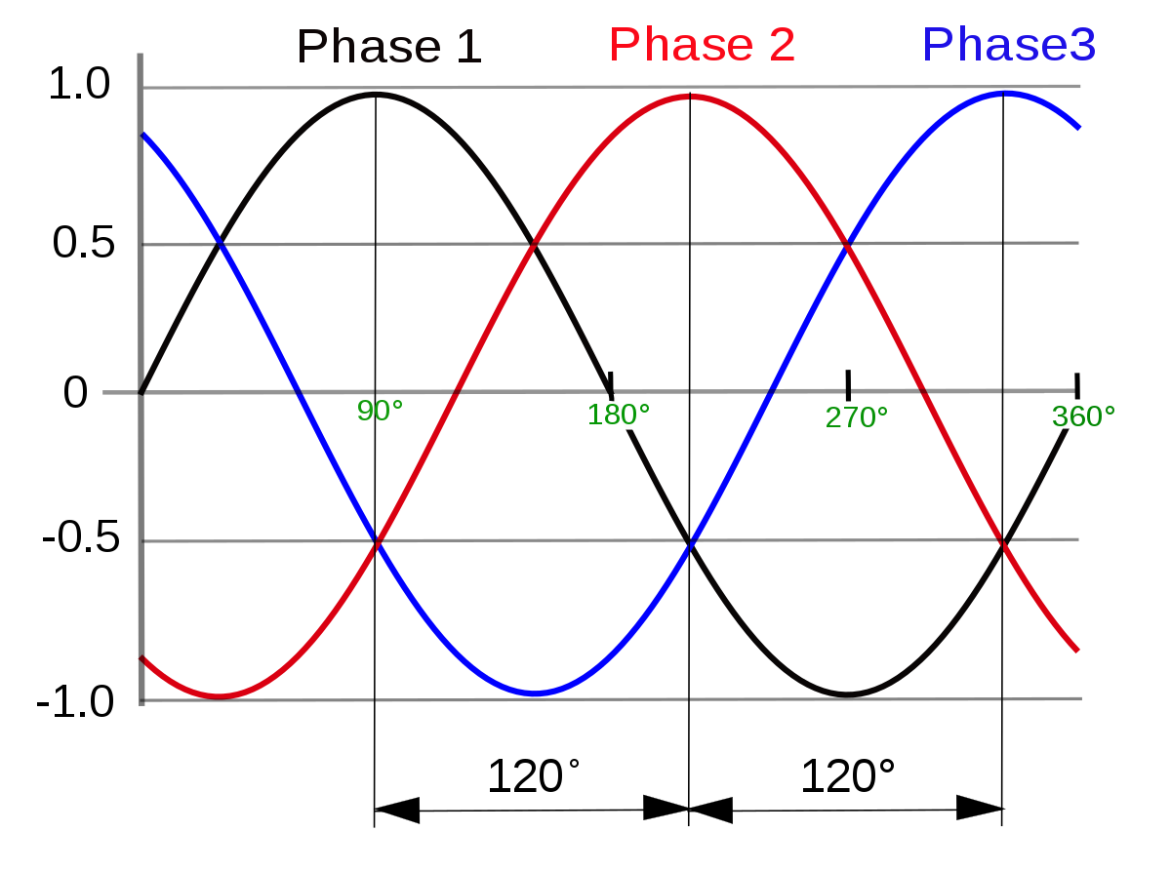
THREE PHASE SUPPLY

Slide 37
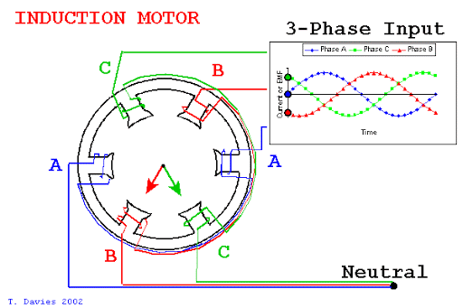


The AC motor working
When 3 phase currents flows in a balanced 3 phase winding, a rotating magnetic field is created which has constant magnitude, but rotates in synchronism with supply frequency.
This speed of rotating magnetic field is SYNCHRONOUS SPEED
Rotating magnetic field is cut by the rotor conductor
EMF is induced in rotor conductor
Current is set up in the rotor
Force F=BIL acts on rotor
Rotor rotates in the same direction as that of rotating magnetic field

Slide 38
The AC motor working
Alternating flux is produced around the stator winding due to AC supply. This alternating flux revolves with the synchronous speed. The revolving flux is called as the "Rotating Magnetic Field" (RMF).
The stator RMF causes an induced emf in the rotor conductors, according to the Faraday's law of electromagnetic induction.
Due to this, a current flows through the rotor conductors which will then cause Force according to F = BIL.
The rotor rotates in the same direction as that of stator flux but never succeeds in catching up with the synchronous speed.
The rotational speed of the rotating magnetic field is called as synchronous speed.

Slide 39
Induction motor operation-Slip
The emf induced and hence the current produced in the rotor conductors is proportional to the difference in the speed of rotating magnetic field and speed of rotor.
If the rotor speed, N = N_{S}
No induced emf in the rotor conductors
No current flow
Hence, N < Ns must for rotor rotation
Slip = (N_{S} – N)/Ns
% s = ^{NS − N} x 100 %
N_{S}

Slide 40


Frequency of Rotor Current

Slide 41

Frequency of Rotor Current – Numerical

Slide 42

Starting Torque of AC motor

Slide 43


Torque under running conditions

Slide 44

Drive circuits for AC motor – Half-bridge inverter

Slide 45

Full-bridge inverter

